Slide 1
All About the Ontario Disability Support Program (ODSP)
Community Presentation

Slide 2
What we’re going to talk about
What are Ontario’s social assistance programs?
What is ODSP income support?
How is ODSP delivered?
Who receives ODSP?
Who is eligible?
Application process
Working while on ODSP

Slide 3
Social Assistance Programs
Ontario Works: provides financial and employment assistance to help people move towards paid employment and independence.
Ontario Disability Support Program (ODSP): provides income support, benefits, and employment supports to enable people with disabilities and their families to live as independently as possible in their communities.

Slide 4
What is ODSP Income Support?
ODSP income support provides financial assistance to eligible people through a basic needs component and shelter allowance based on family size, make-up and other factors.
The basic needs component helps with the cost of food, clothing and other necessary personal items and expenses.
The shelter allowance helps to pay for:
shelter costs, such as a mortgage or rent; and
shelter-related costs, such as property taxes, utilities and home insurance premiums.

Slide 5
Income Support Benefits
Individuals receiving ODSP income support may also receive assistance for:
Dental Care* | Prescription drugs
Medical travel and transportation | Employment and Training Start-up
Vision care | Hearing Aids
Diabetic Supplies | Special Diets
Repairs and Batteries for Mobility Devices | Surgical and Incontinence Supplies
Guide, hearing or service dogs
*Note: Anyone on ODSP under 18 years of age would receive dental care through the Healthy Smiles Ontario program of the Ministry of Health and Long-Term Care.

Slide 6
Who receives ODSP?
356,097
Cases
490,242
Beneficiaries
68,862
Children
Of the overall ODSP caseload as of June 2017:
almost 78% are single people with a disability;
53% are male, 47% are female;
25% are under 35 years old.
Approximately 20% of individuals receiving ODSP have post-secondary education; 33% have high school; and 47% have grade 11 or less.
Many individuals receiving ODSP want to work but face barriers. They tend to be more distant from the labour market, so may require support in becoming employment-ready.

Slide 7
Disability profile

Slide 8
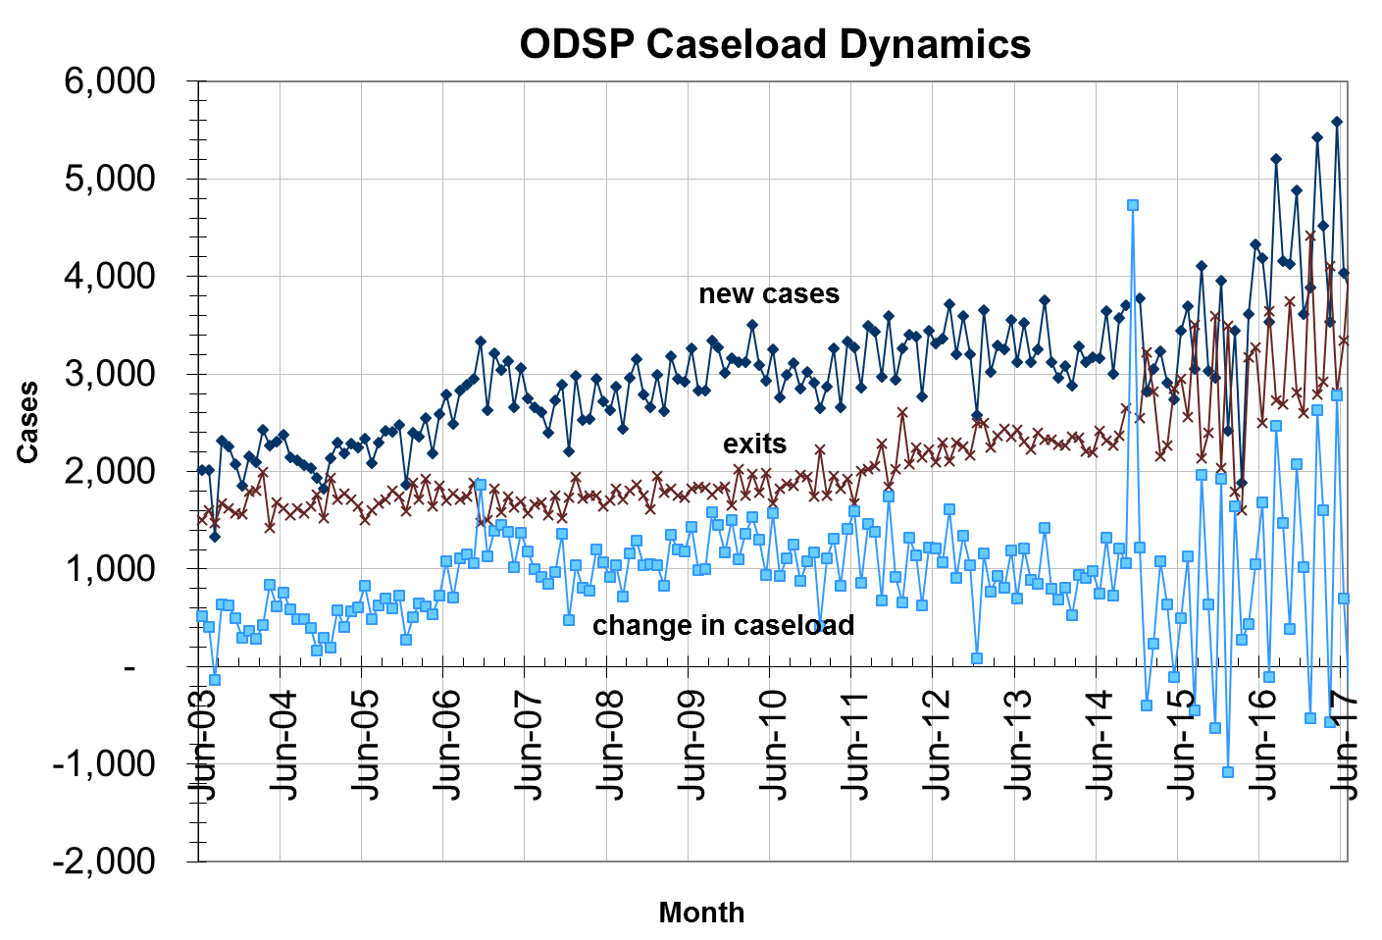
Average time on ODSP
Compared to the Ontario Works caseload, the ODSP caseload tends to have a relatively lower rate of turnover:
Since 2006-07, new cases coming onto ODSP have represented about 1.2% of the caseload
The number of exits, as a percentage of caseload, has been rather stable at about 0.8%, on average, since 2003-04. Individuals exit primarily due to death or as they access other income sources such as Old Age Security
ODSP Cases
by Time on Assistance, June 2017
(months)
8

Slide 9
ODSP Delivery
ODSP is delivered by ministry staff in nine regions and 47 local offices.
ODSP employment support services are delivered by a network of approximately 150 community-based service providers.
A customer-centered service delivery and staffing model provides a “one window” case management approach.
Caseworkers:
manage all aspects of a person’s file, including income and employment supports;
help people to establish their goals and develop a plan to overcome possible barriers to achieving those goals; and
work closely with agencies at the local level and make referrals to other human services as needed.

Slide 10
Who is eligible?
To be eligible for ODSP income support, a person must be:
a resident of Ontario;
18 years of age or older;
in financial need; and
have assets no greater than the limits set out in the ODSP regulation.
And either be
deemed to be a “person with a disability” under the ODSP Act;
or
qualify as a member of a prescribed class.

Slide 11
Application Process
Step 1: Determination of Financial Need
Income
Assets
Expenses, such as shelter costs
Family size and make-up
Step 2: Determination of Disability or
Verification of Prescribed Class
Applicants can begin the process online, or contact their local ODSP office.
Individuals receiving Ontario Works can apply for ODSP through their Ontario Works office.

Slide 12
Step 1: Financial Eligibility
Assessment of financial eligibility takes into account:
personal circumstances (e.g., family size, living arrangements, shelter costs);
income from all non-exempt sources;
and assets.

Slide 13
Financial Eligibility (cont’d)
Income is deducted dollar-for-dollar from an individual’s monthly income support unless exempted by regulation:
Earnings are treated differently from other income. The first $200 earned each month is fully exempt under the flat rate exemption.
Thereafter, each $1 of earnings reduces monthly income support by $0.50.
People are always financially better off working.
Gifts and voluntary payments for any purpose are exempt as income up to $10,000 in any 12-month period for the recipient and each member of the benefit unit.
In addition, all gifts and voluntary payments used for approved disability-related items or services, for first and last month’s rent necessary to secure accommodation, to purchase a principal residence, or to buy an exempt vehicle are exempt as income, regardless of the amount (pre-approval is required).

Slide 14
Financial Eligibility (cont’d)
ODSP asset limits:
$40,000 for a single person
$50,000 for a couple
An additional $500 for each dependent other than a spouse.
With prior approval, the asset limit may be increased to:
allow purchase of items necessary for the health of a member of the benefit unit, or for disability-related items or services.
In addition, a number of assets are exempt by regulation and do not count towards an individual’s asset level. For example:
A principal residence, one motor vehicle, or a Registered Disability Savings Plan (RDSP).

Slide 15
Step 2: Disability Determination
Under the ODSP Act, a “person with a disability” is a person who has a substantial physical or mental impairment that is:
continuous or recurrent; and
is expected to last one year or more.
In addition, the physical or mental impairment must directly result in a substantial restriction in the person’s ability to:
work;
take care of him or herself; or
take part in community life.
The impairment(s), its duration, and the restriction(s) must also be verified by an approved health care professional.

Slide 16
Disability Determination (cont’d)
If a person’s condition is expected to improve, a medical review date is set, as per the requirements in the regulation
Unless applicants are in a prescribed class, they must go through an adjudication process to determine if they qualify for ODSP as a person with a disability.

Slide 17
Prescribed Classes
Members of these prescribed classes do not have to go through the disability determination process:
People aged 65 or older who are not eligible for federal Old Age Security.
People receiving disability benefits under the Canada or Quebec Pension Plans.
People who are eligible for services, supports and funding under the Services and Supports to Promote the Social Inclusion of Persons with Developmental Disabilities Act (SIPPDA).
Former and current residents of certain provincial institutions and provincially regulated homes.

Slide 18
Disability Adjudication Unit
The Disability Adjudication Unit (DAU) is the centralized unit within the ministry that reviews applicants’ medical information and determines whether they meet the definition of disability under the ODSP Act.
Local ODSP and Ontario Works offices refer applications to the DAU.
The ODSP application is called a Disability Determination Package (DDP), and includes the following forms:
Health Status Report
Activities of Daily Living Index
Self Report Form
Consent to the Release of Medical Information
Instruction Sheet
The ministry’s service standard for determining disability is 90 business days from the date the completed DDP is received.

Slide 19
Eligible Individuals
The ODSP Caseworker:
aims to grant income support benefits within 21 days after:
financial need has been verified; and
the individual has been determined disabled or verified as a member of a prescribed class.
meets with new individuals within three months to review:
program benefits and supports – income and employment; and
individual rights and responsibilities.

Slide 20
Sample Rates
In addition to basic needs and shelter, a person may be eligible for: the special diet allowance, the pregnancy/breast-feeding nutritional allowance or the remote communities allowance.
Additional assistance is available to low-income families with children through the Ontario Child Benefit as well as the federal Canada Child Benefit.

Slide 21
ODSP and Working

Slide 22
What are ODSP Employment Supports?
ODSP provides employment supports for people who are interested in working.* The program can help people:
become employment-ready;
find and keep a job;
advance their careers; and
start their own business.
People do not need to be receiving ODSP income support to qualify for employment supports.
*Note: Participation in employment supports is voluntary for individuals with disabilities receiving ODSP. Non-disabled adult family members are required to participate in Ontario Works employment assistance, unless they are waived from participating.

Slide 23
Employment services
Here are some examples of the kinds of services that may be provided:
workshops on looking for work, resumé-writing and interviewing;
referrals to job counselling or short-term job-specific training;
information on who is hiring;
access to education, so individuals can finish high school or improve their language skills;
access to telephones, faxes, computers and job banks;
help developing a plan to become self-employed; and
volunteer placements or job trial that can help individuals practice their skills and improve confidence.

Slide 24
Rules about working
There are no rules prohibiting a person receiving ODSP from working.
While a restriction in ability to work is one factor considered as part of disability determination, the ODSP Act does not say a person must be unable to work to qualify for ODSP.
There are many supports to foster employment, primarily through ODSP employment supports. These services are provided by approximately 150 community-based service providers, many of which have expertise in working with people with disabilities and local employers.

Slide 25
Myth #1:
Individuals are not allowed to work while on ODSP.
Fact:
Individuals can work and still receive ODSP.
A caseworker can:
connect individuals to services that will help them get ready for and find work; and
help pay for start-up costs, like work clothes and child care.

Slide 26
Myth #2:
When individuals work, their ODSP income support goes down – so it’s not worth it.
Fact:
Individuals who work while on ODSP are always better off financially than those who don’t.
Individuals can earn up to $200 each month without affecting their ODSP.
Every dollar earned over $200 only reduces a person’s income support by 50 cents.

Slide 27
Myth #3:
Individuals will lose their health benefits if they leave ODSP.
Fact:
Individuals who leave ODSP because of high earnings will continue to receive at least drug, dental and vision care benefits as well as batteries and repairs for mobility devices from ODSP unless their employer provides the same benefits.

Slide 28
Myth #4:
Individuals can’t get back on ODSP if their earnings decrease or they lose their job.
Fact:
Individuals who leave ODSP because of high earnings:
can return to ODSP as long as they qualify financially.
will not have to go through disability adjudication to be reinstated.

Slide 29
Earnings Exemptions and Allowable Expenses
The first $200 of individuals’ monthly after-tax earnings won’t affect the amount of their ODSP.
Some disability-related work expenses can also reduce the amount that is deducted from an individual’s ODSP.
Individuals who are in post-secondary school full-time can keep any earnings without affecting ODSP.
Every dollar individuals earn above $200 only reduces ODSP by 50¢.
Most child care costs can be expensed and reduce the amount that is deducted from ODSP.

Slide 30
Disability-related costs
For every month with earnings, up to $1,000 can be claimed for eligible, disability-related work expenses such as special equipment or special transportation.
These costs are subtracted from earnings when calculating ODSP income support.

Slide 31
Child care costs
Child care costs will be deducted from earnings when ODSP income support is calculated.
For licensed child care and before and after-school programs as part of full-day kindergarten, the full cost will be deducted.
For unlicensed child care, up to $600 per month can be expensed.

Slide 32
Working while in school
Earnings of full-time students are not deducted from ODSP.
OSAP funds for educational costs, local transportation and child care are fully exempt and do not impact ODSP income assistance.
Post-secondary students can continue to receive funds for living expenses through ODSP while they are in school. They are not required to access OSAP funds to cover their living expenses. However, if they choose to do so, OSAP funds that exceed actual educational, transportation and child care costs are treated as income and are deducted dollar for dollar from ODSP.

Slide 33
Calculating the earnings deduction
1. APPLY EARNINGS EXEMPTIONS
 | Take home pay (after mandatory deductions, i.e. CPP, EI, Tax, Union dues) | $600
Less | $200 Flat rate exemption | $ 200
 |  | $400
Less | 50% exemption ($400x50%) | $200
 | Chargeable earnings so far: | $200
2. DEDUCT EXPENSES
Less | Disability-related work expenses | $50
Less | Licensed child care expenses | $100
 | Final chargeable earnings | $50

Slide 34
Reporting earnings
Each month, individuals must report their earnings (covering the first day of the month to the last day of the month) to the ODSP office.
Individuals fill out the Employment/Training Income Report (ETIR) and submit it to the local ODSP office by the 7th day of the next month.
ODSP will use this information to calculate the amount of ODSP income support at the end of each month.

Slide 35
Benefits of working
People with disabilities on ODSP do not have to take part in employment-related activities. But if they do work, they will:
see their income increase;
continue to have health benefits; and
experience the social benefits of working.

Slide 36
Leaving ODSP for work
ODSP will continue to provide health benefits if the individual is eligible for:
Extended Health Benefits: provides coverage of all ODSP health benefits if a person leaves ODSP and their eligible health costs exceed their excess income. The person must remain eligible for ODSP in all other respects (e.g., meet ODSP asset levels).
OR
Transitional Health Benefits: provides coverage of drug, dental and vision care costs and batteries and repairs for mobility devices if a person leaves ODSP for work and doesn’t qualify for Extended Health Benefits and their employer does not provide comparable benefits.
Individuals whose earnings decrease, who leave/lose their job or leave for any reason, can come back to ODSP without going through the disability adjudication process again.

Slide 37
Need more information?
Additional program information is available on the MCSS website at www.ontario.ca/socialassistance.

